Slide 1

PREDICTED BITCOIN PRICES AND RETURNS WITH ML ALGORITHMS
Kirill Gusev 01429691
Lara Grein 12134930

Slide 2
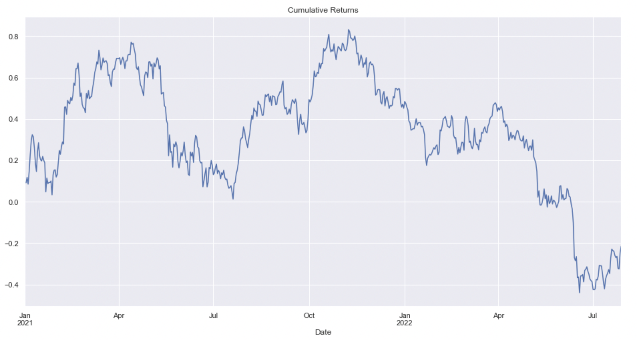
THE OBJECTIVE & DATA COLLECTION
Predict the direction of Bitcoin prices for the next day or week
High frequency data from 2021-01-01 till 2022-07-29
Data obtained from coinbase public client

Slide 3
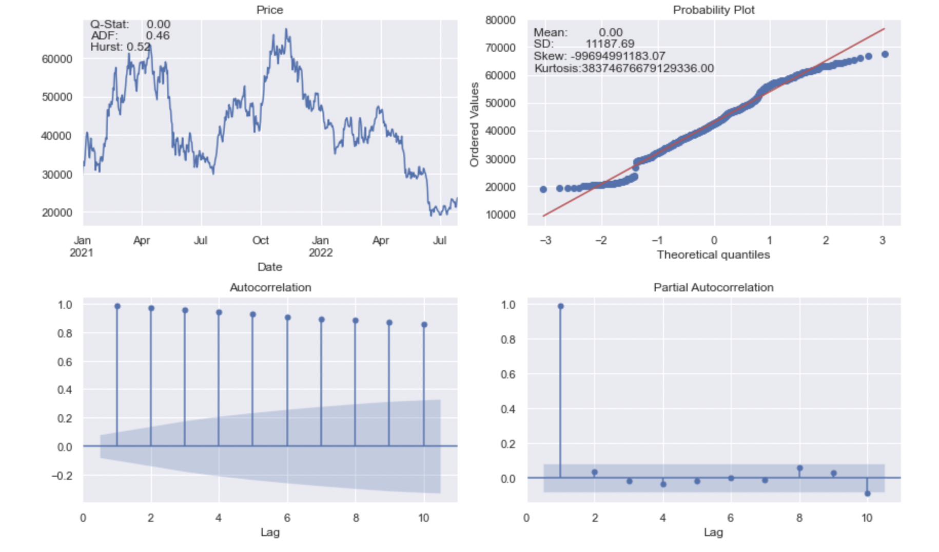
PRELIMINARY ANALYSIS OF THE DATA [1]

Slide 4
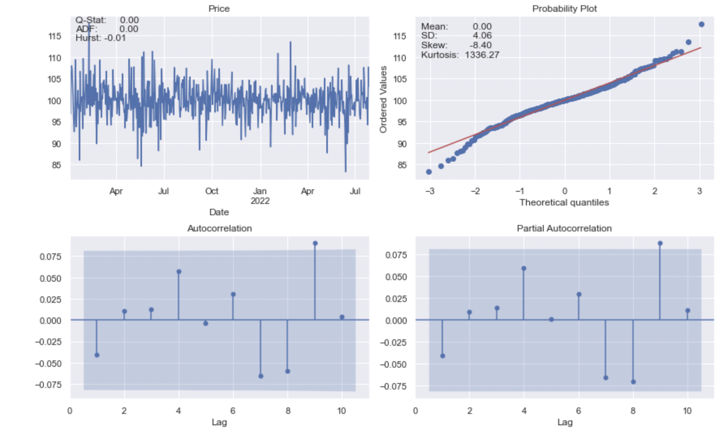
PRELIMINARY ANALYSIS OF THE DATA [2]

Slide 5
MODEL CONSTRUCTION: SVR
1.
2.
3.
4.
Choose the time interval for prediction counted in the number of days n
Choose how many days will be predicted in the one window
We choose number of days for training sample - d
Choose the kernel for svr algo

Slide 6
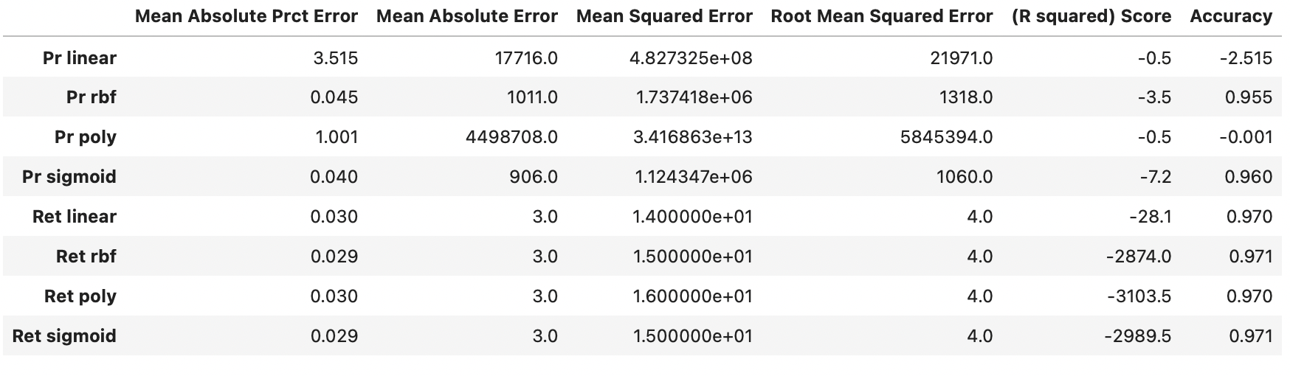
MODEL PERFORMANCE: SVM
From the analysis below: ‚rbf‘ and ‚poly‘ kernels for price and returns-based models
Intra-daily data to predict the last price of the day

Slide 7
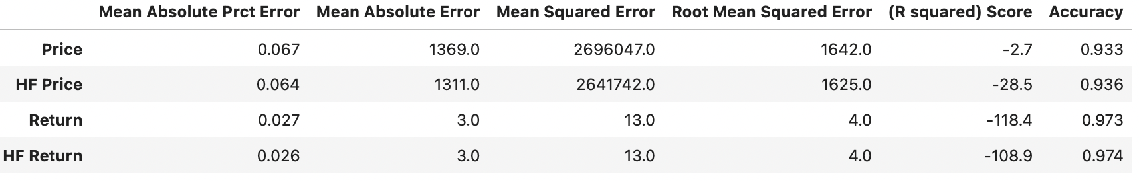
MODEL PERFORMANCE: RFR
All metrics show that models based on hf data have better prediction power, especially for the small amount of predicted days - p but this improvement becomes indistinguishable with increase in predicted days.

Slide 8
MODEL CONSTRUCTION: RFR
1.
2.
The function for random forest regressor resambles the structure of SVR function above with one difference.
The best parameters are determinde whithing the function. For further info, look the supfunc.py file.

Slide 9
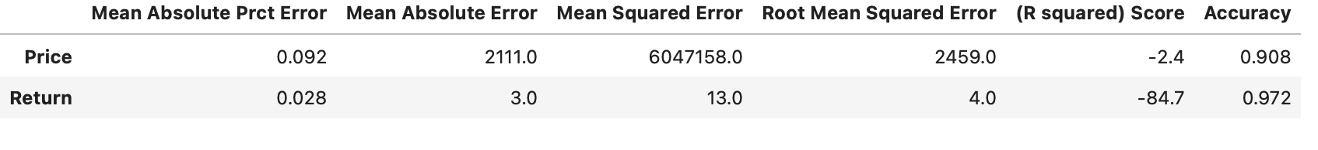
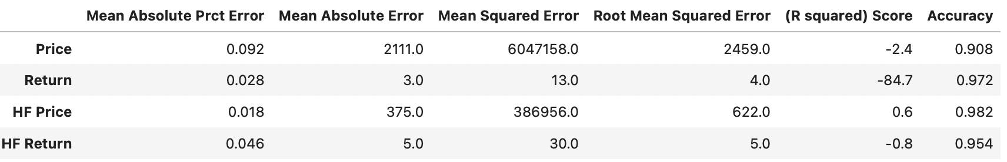
USING DAILY DATA
USING INTRA - DAILY DATA

Slide 10
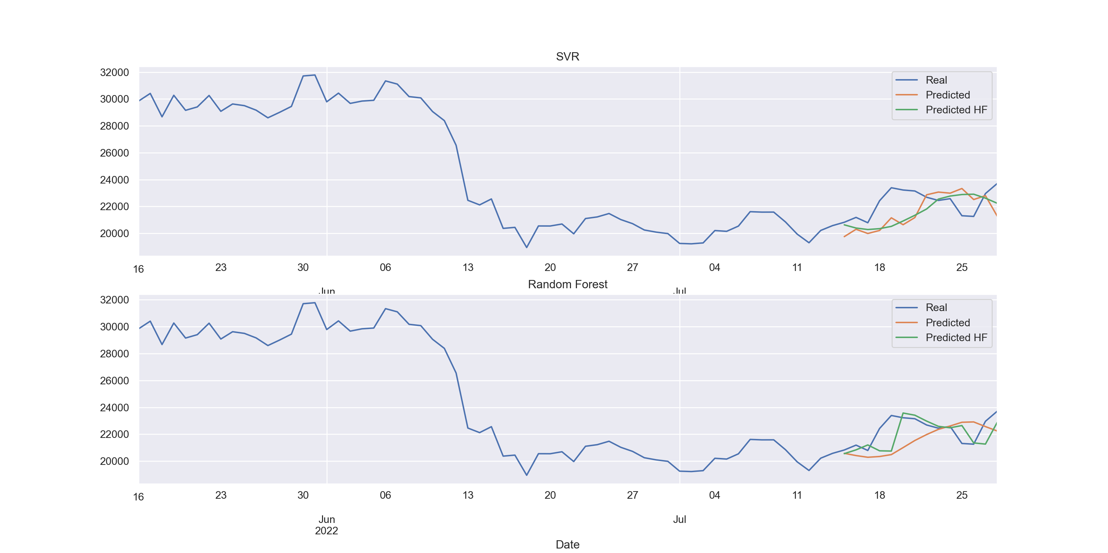
PLOTTED RESULTS

Slide 11
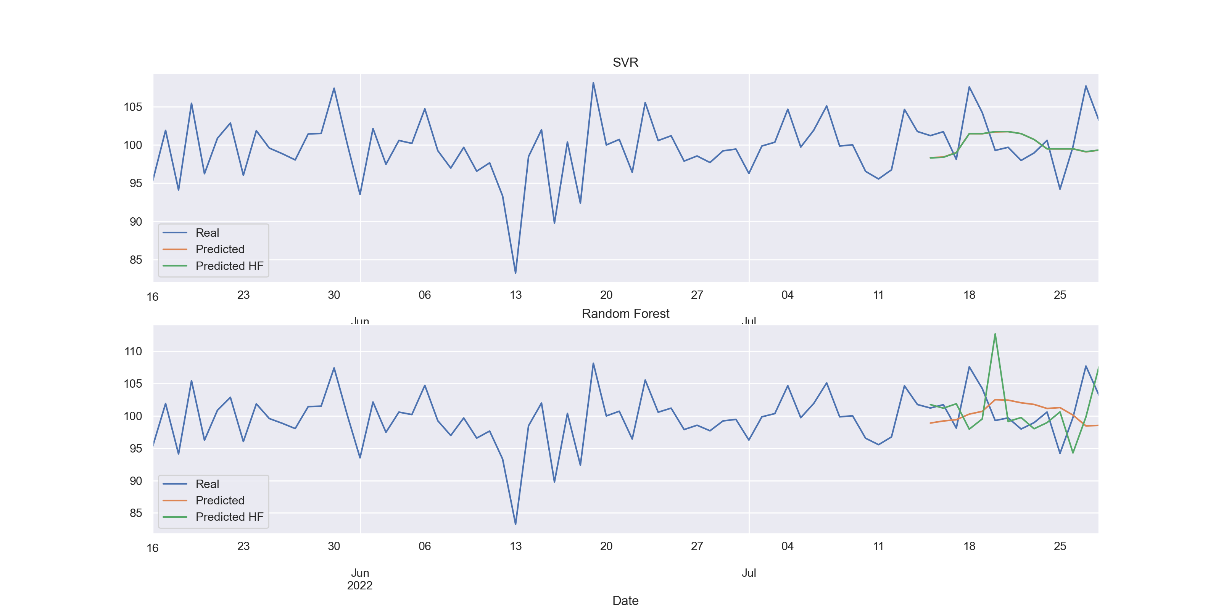
PLOTTED RESULTS

Slide 12


CONCLUSION
Results of the analysis of both models in different market situations could be represented as follows:
RFR showed a better performance in terms of the metrics and on the larger timescale.
SVR is more appropriate in the appearance of high volatility of prices/returns, whereas the RFR model provided good measures in stable periods.

Slide 13
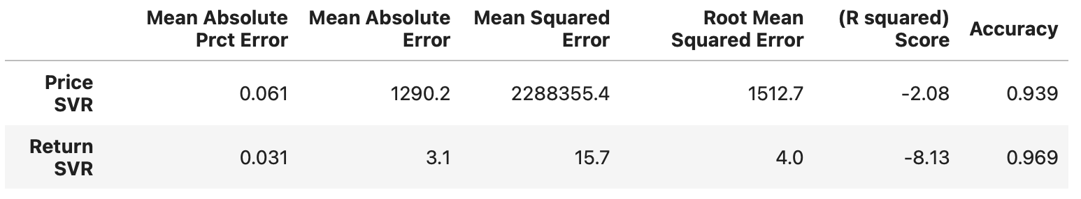
Appendix
Additional variables don‘t have any significant effect
HL-diff = High – Low and
CO-diff = Close – Open

Slide 14

THANK YOU FOR YOUR ATTENTION!

